Slide 1
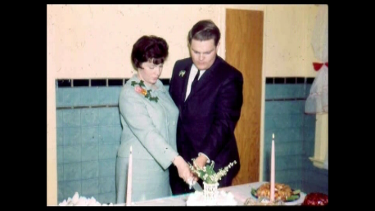
My Grandparents
By Cameron Anthony

Slide 2
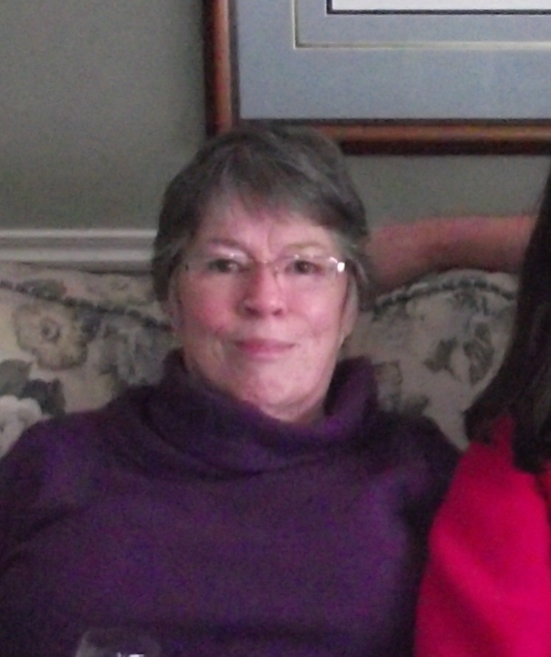
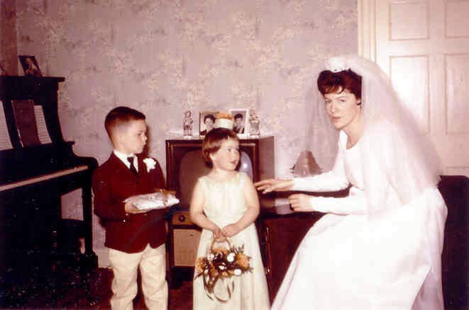
Do you know who this is?
May 21,1966
This is my grandmother, her name is Donna Renfrew.

Slide 3
Her parents names were Mary & Arthur Taylor.
She was born on April 10, 1942. She just turned 70.
She has 1 sister (5 siblings that died as infants)
Her favourite games as a child were hide and seek in a big house and on a farm. She played with paper dolls, marbles, hop scotch and a doll. Her favourite place to play as a child was at her cousins, they had a farm and lots of kids. She had no T.V. But one thing she did have was fun.
She doesn’t work now, but she worked as a lab technician, as a florist and a merchandiser.
My grandmother is not shy at all. She loves working with flowers. And since her stroke 2 years ago, she loves doing puzzles. She is really good at them. We gave her a puzzle for her birthday called “Grandma’s Kitchen”.

Slide 4
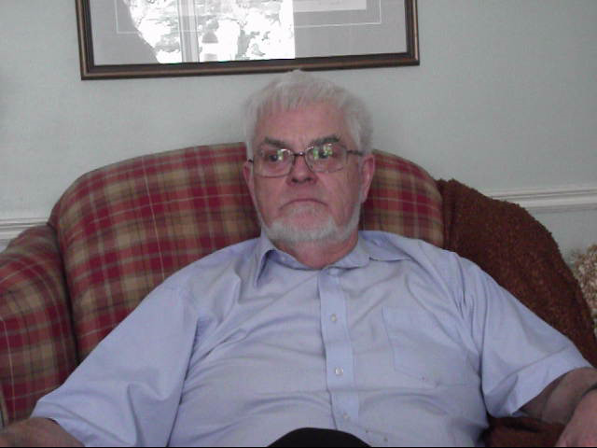
My Grandpa, Glen Renfrew

Slide 5
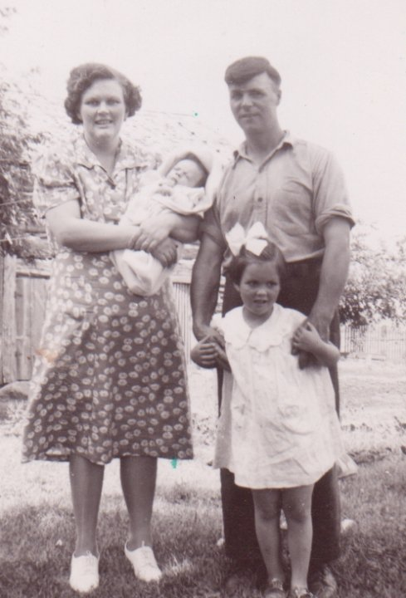
This is my great-grandparents Margaret & Albert (Bert) Renfrew with my grandpa as a baby and my great aunt Helen.
July 1943

Slide 6
These are my Grandparents
By Cameron Anthony

